Slide 1
Kinematics and Dynamics of Robots
Spring Semester 2021
Lecturer: Yoav Golan

Slide 2
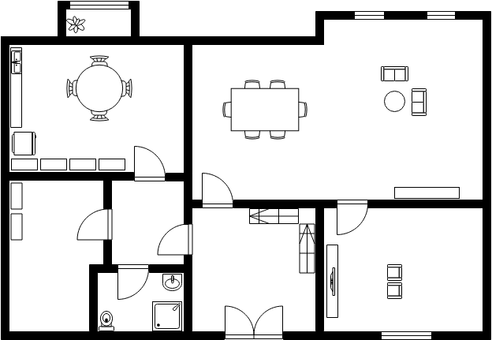
Configuration Space

Slide 3
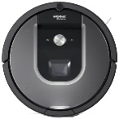
Configuration Space

Slide 4
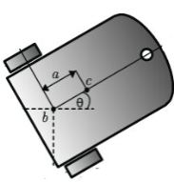
Configuration Space

Slide 5
Configuration space
We want to represent a robot’s complete configuration as a single point
We work in n-dimensional Configuration space, or C-Space
Free space – valid configurations
Obstacles – invalid configurations

Slide 6
Configuration Space Obstacles
Demo

Slide 7
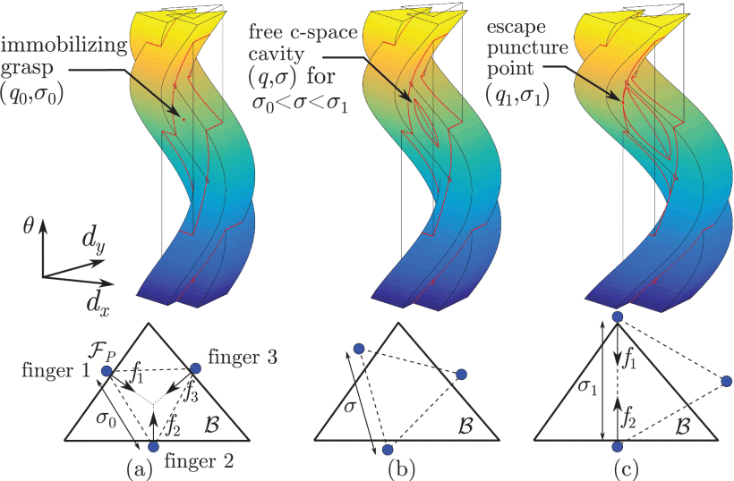
Configuration Space Obstacles

Slide 8
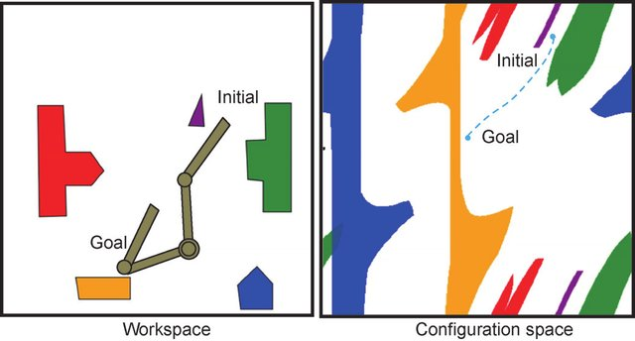
Configuration Space

Slide 9
Configuration Space Obstacles
How do we find the C-Obstacles?
Analytic approach
Brute-Force sampling
Stochastic sampling

Slide 10
Configuration Space
RR Demo

Slide 11
Configuration Space
A point in C-Space = A robot configuration
A path in C-Space = A robot’s continuous motion from one configuration to another
Any point inside a C-Obstacle = An invalid configuration (collision with an object)
A point on the surface of a C-Obstacle = The robot is touching a real obstacle

Slide 12
Configuration Space
The computation power and memory problem

Slide 13
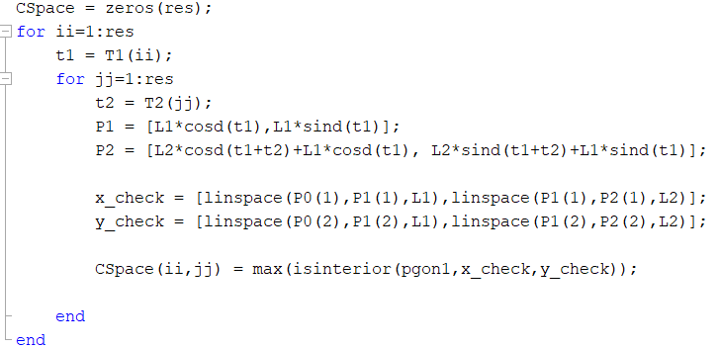
Computing Configuration Space
Computing one cell:

Slide 14
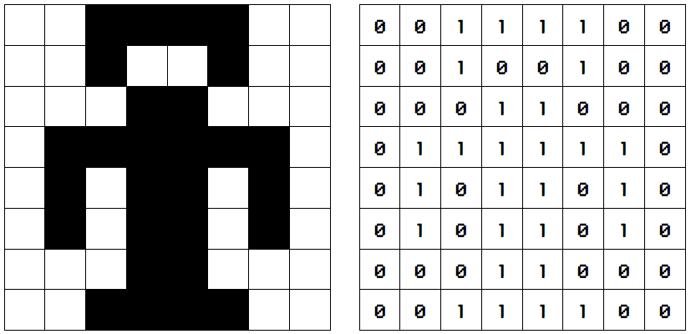
Configuration Space
The (bigger) memory problem
8X8 grid. Memory required: 8² = 64 bits
= 8 bytes

Slide 15

Configuration Space
The (bigger) memory problem
360X360 grid. Memory required: 360² = 129,600 bits
= 16.2 kilobytes

Slide 16
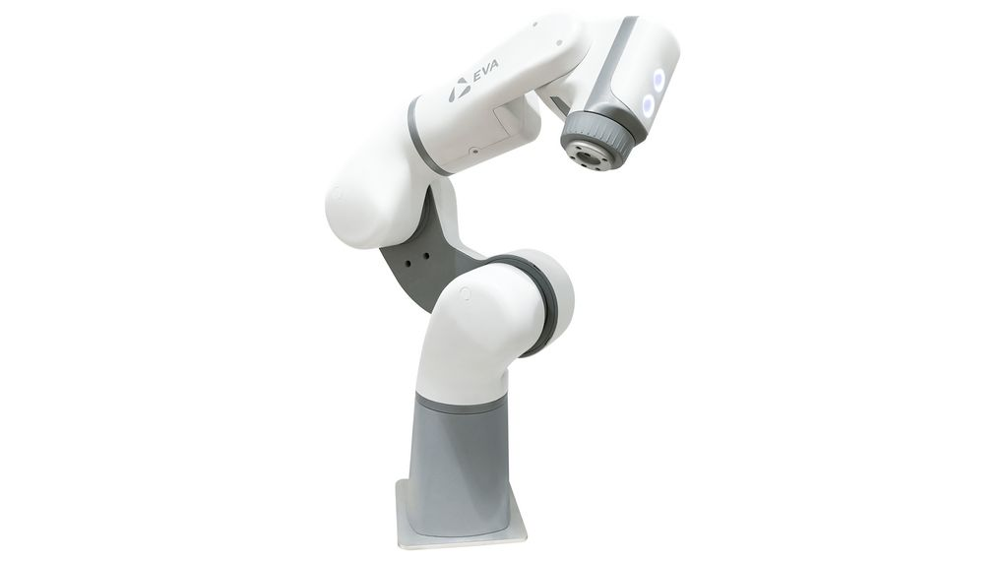
Configuration Space
The (bigger) memory problem
n=6
Memory required: 360⁶ = 2.721*10¹⁴ bits
= 272.1 terabytes

Slide 17
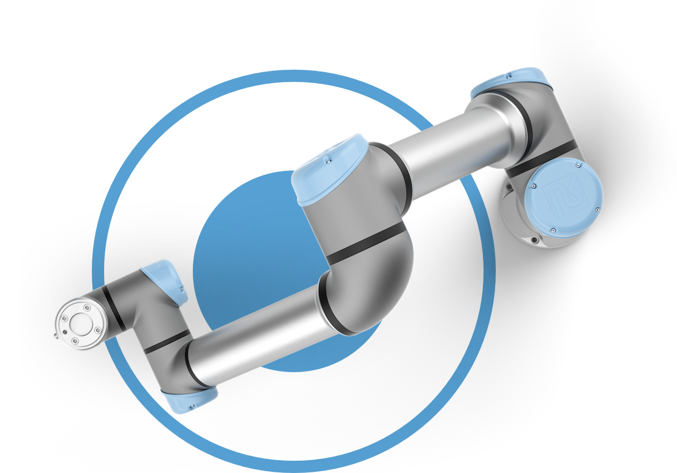
Configuration Space
Maybe 360 is too precise?
0.85m
1.5 cm
1º

Slide 18
Configuration Space
Motoman UP6
Joint 1: Range- 340º, Pulses per degree- 1,492.764.
Total: 507,540 Pulses
Joint 2: Range- 245º, Pulses per degree- 1,517.037.
Total: 371,674 Pulses
Joint 3: Range- 360º, Pulses per degree- 1,264.198.
Total: 455,111 Pulses
Joint 4: Range- 360º, Pulses per degree- 910.222.
Total: 327,680 Pulses

Slide 19
Configuration Space
Motoman UP6
Joint 1: 507,540 Pulses
Joint 2: 371,674 Pulses
Joint 3: 455,111 Pulses
Joint 4: 327,680 Pulses
Joint 5: Range- 270º, Pulses per degree- 916.543.
Total: 247,467 Pulses
Joint 6: Range- 720º, Pulses per degree- 573.299.
Total: 412,775 Pulses

Slide 20
Configuration Space
Motoman UP6
Joint 1: 507,540 Pulses
Joint 2: 371,674 Pulses
Joint 3: 455,111 Pulses
Joint 4: 327,680 Pulses
Joint 5: 247,467 Pulses
Joint 6: 412,775 Pulses
Total bits for C-Space: 507,540 * 371,674 * 455,111 * 327,680 * 247,467 * 412,775
= 2.874*10³³ bits
= 35,92,000,000,000,000,000,000 terabytes

